Slide 1

Welcome
Good morning everyone, and welcome to my presentation . My name is Suman Adhikary, and I am excited to be here today to share some insights and ideas with you. Before we get started, I would like to express my gratitude for your time and attention, and I hope that you will find this presentation informative and engaging. So, let's dive in!"
Photo by Pexels

Slide 2

Acknowledgemt
Introduction
Objectives
Features
Platform Used
Analysis
Design
Coding
Testing
Limitation and Conclusion
Reference
Photo by Pexels

Slide 3

Acknowledgement
I would like to express my special thanks of gratitude to my teacher (Khem Raj Poudel) who gave me the golden opportunity to do this wonderful project on the topic, which also helped me in doing a lot of Research and i came to know about so many new things I am really thankful to them. Secondly i would also like to thank my parents and friends who helped me a lot in finalizing this project within the limited time frame.
Photo by Pexels

Slide 4

Introduction
Travelling is one of the most enriching experiences a person can have. It broadens your horizons, exposes you to new cultures and ways of life, and helps you create unforgettable memories. However, planning a trip can be overwhelming and time-consuming. That's where our travelling website comes in.
Photo by Pexels

Slide 5

Objective
To provide information about a particular topic, such as news, research, or educational content.
To share knowledge and expertise on a particular topic or area of interest, through blog posts, tutorials, or other types of content.
To develop knowledge and skills.
Photo by Pexels

Slide 6

Features
User-Friendly Interface
Clear and Structured Website Navigation
Accurate and Reliable Information
Photo by Pexels

Slide 7
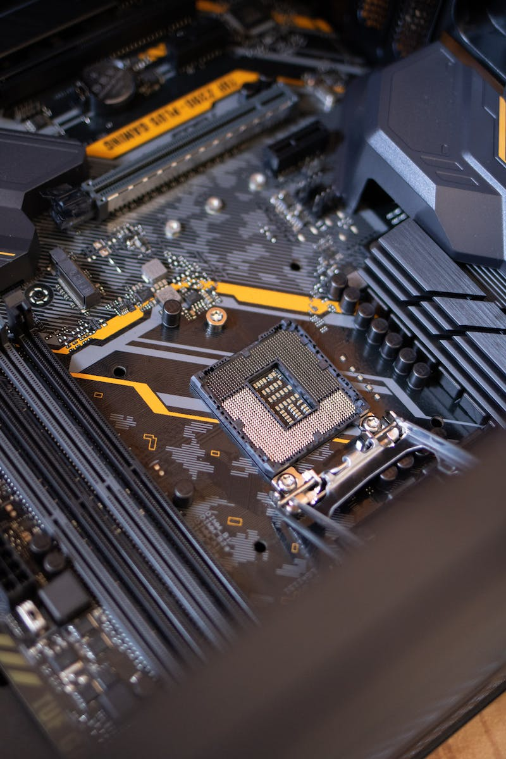
Platform Used
VS CODE
SUBLIME TEXT
HTML EDITOR
Photo by Pexels

Slide 8

Analysis
Before you begin creating a website, it's important to analyze your goals, audience, and competition. This includes determining the purpose of your website, identifying your target audience, and researching your competitors' websites. This analysis will help guide the design and development of your website.
Photo by Pexels

Slide 9
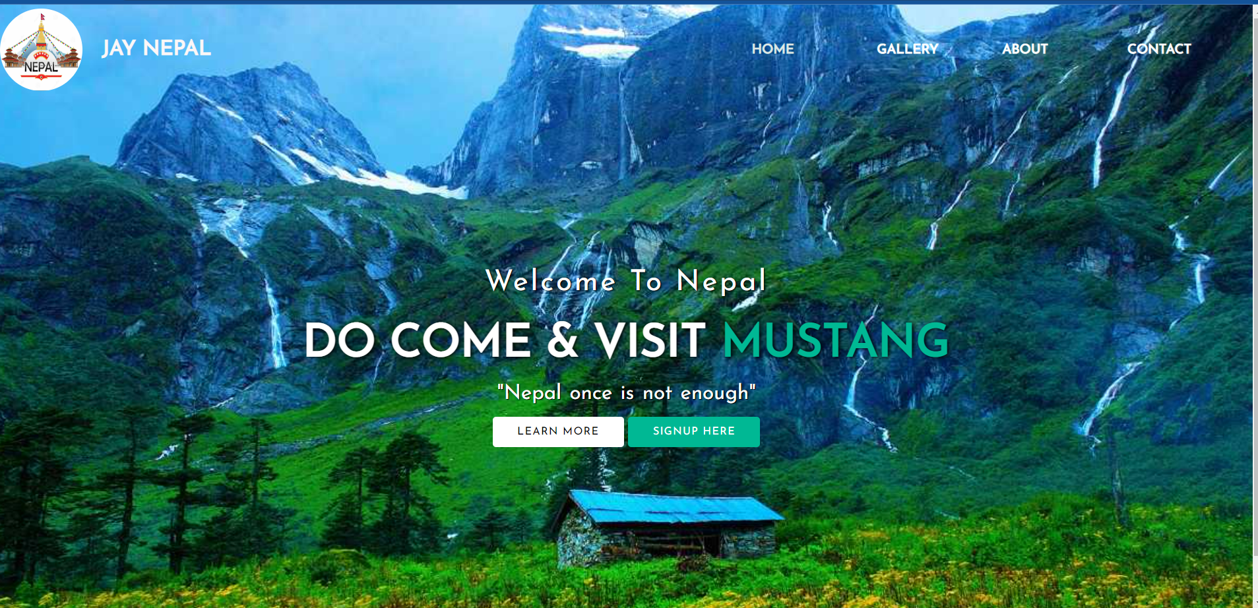
Design
Photo by Pexels

Slide 10
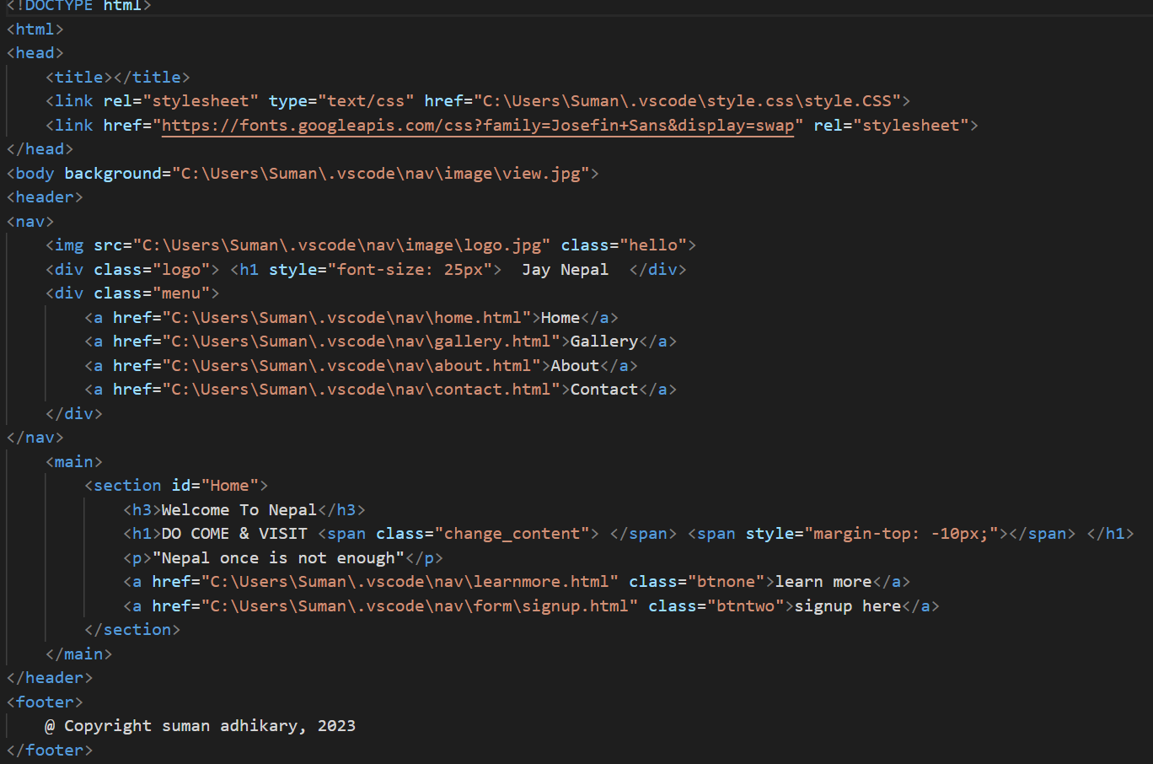
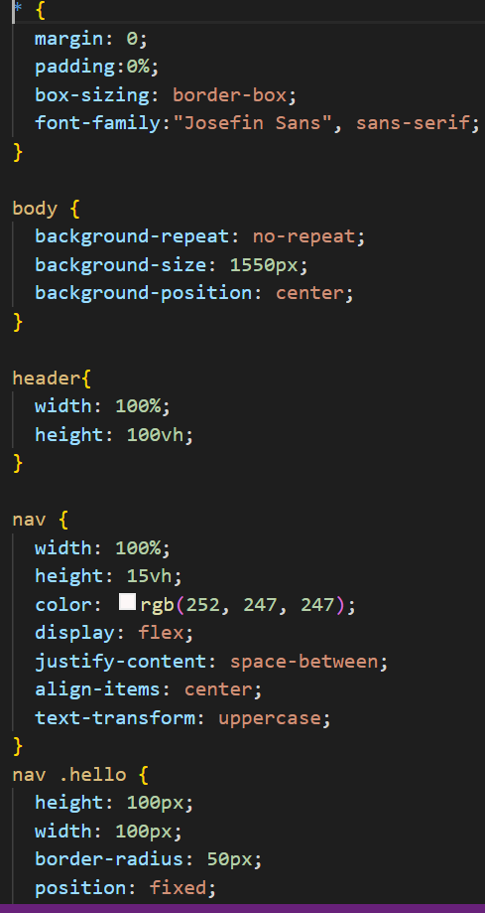
Coding
Photo by Pexels

Slide 11
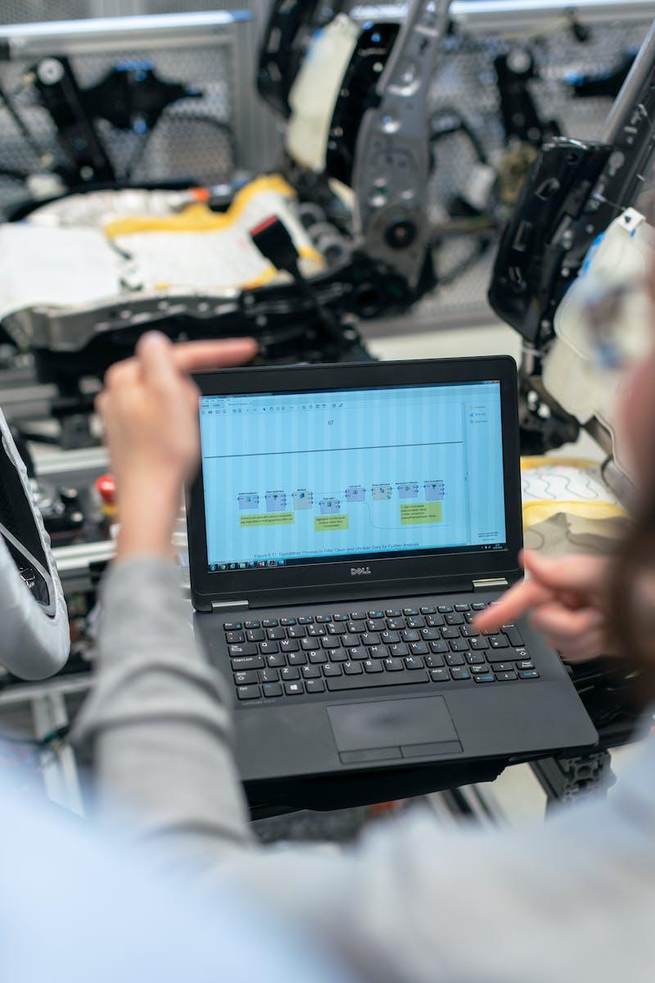
Testing
After the coding is complete, it's time to test website. This includes testing for usability, accessibility, and compatibility. Usability testing involves testing the website's functionality and ease of use, while accessibility testing ensures that the website is accessible to users with disabilities. Compatibility testing ensures that the website works on different devices and browsers.
Photo by Pexels

Slide 12
Limitation and Conclusion
Creating a website has several limitations such as technical, time constraints, limited functionality, compatibility issues. Despite these limitations, with careful planning and execution, it's possible to create a functional and aesthetically pleasing website that meets your goals and objectives. Remember to also prioritize website security and compatibility with different devices and browsers to ensure a positive user experience.
Photo by Pexels

Slide 13
Reference
W3Schools https://www.w3schools.com
MDN Web Docs(https://developer.mozilla.org/en-US/)
Codecademy (https://www.codecademy.com/learn)
Chatgpt and Youtube
Photo by Pexels

Slide 14
Thank You!
Thank you for taking the time to learn about creating a website. I hope this presentation has been informative and helpful.
Photo by Pexels

